Slide 1
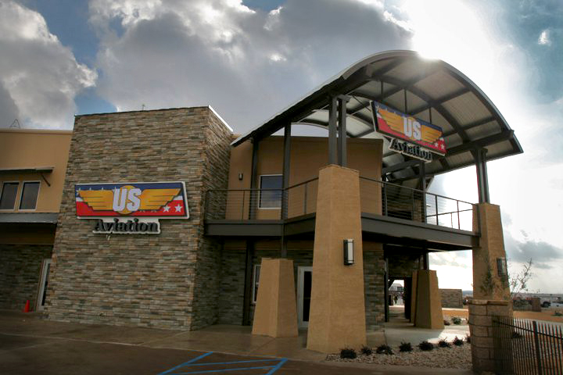
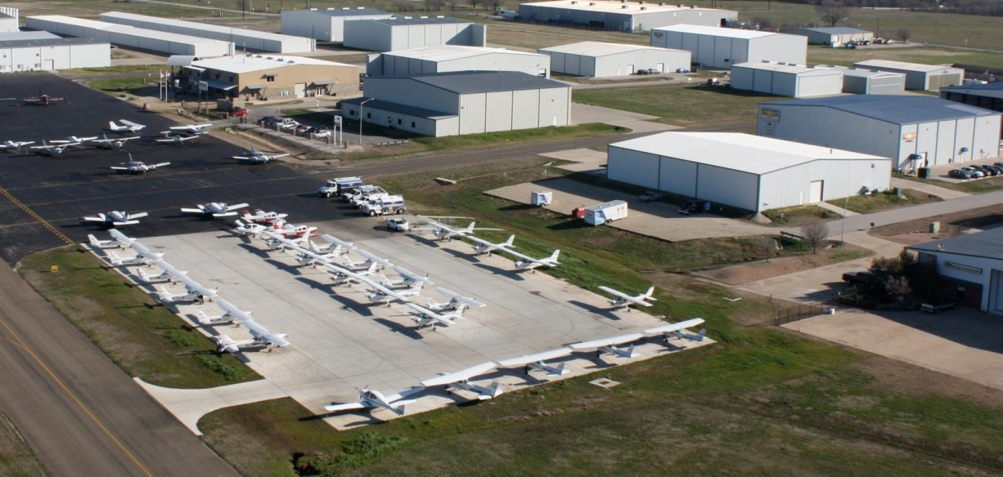
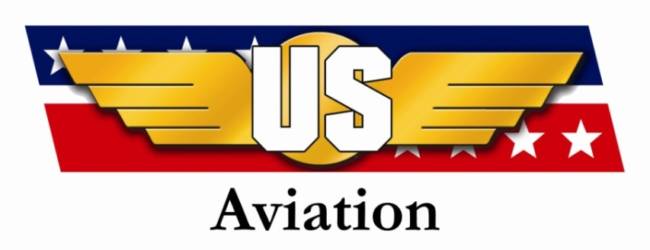
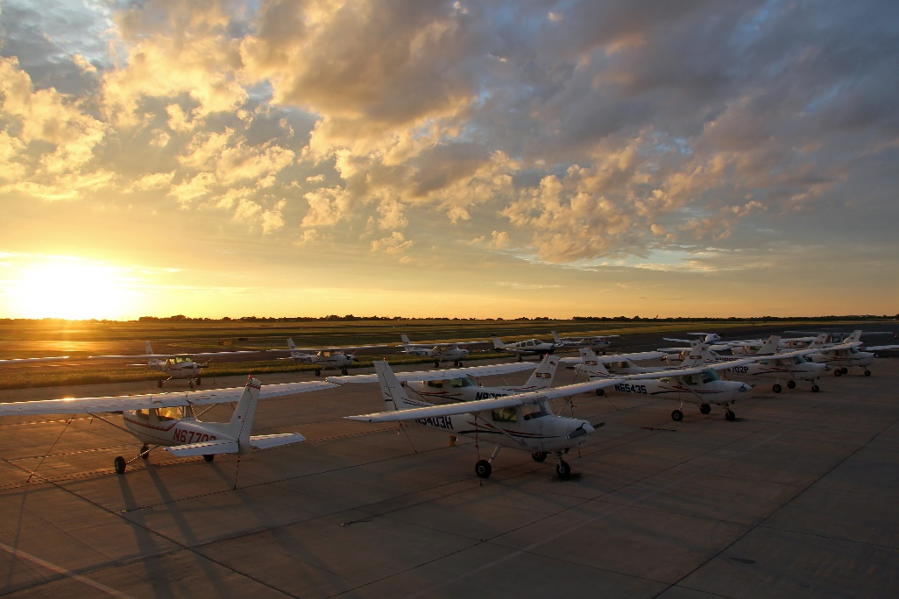
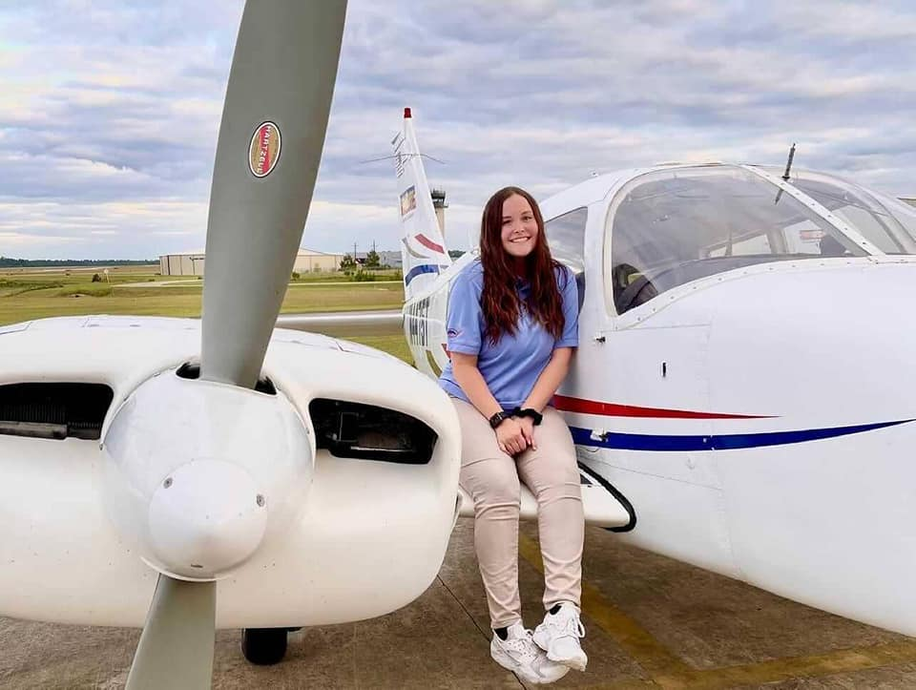
US Aviation

Slide 2
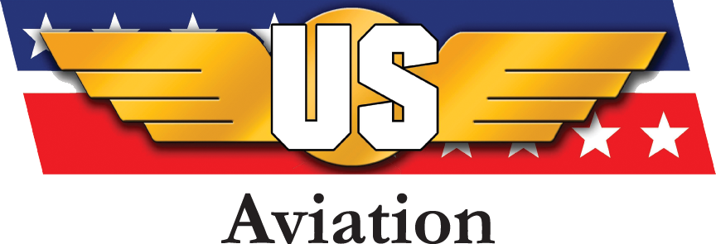
US Aviation Group
“US Aviation provides world class professional flight training and aviation services and support to global customers.”

Slide 3
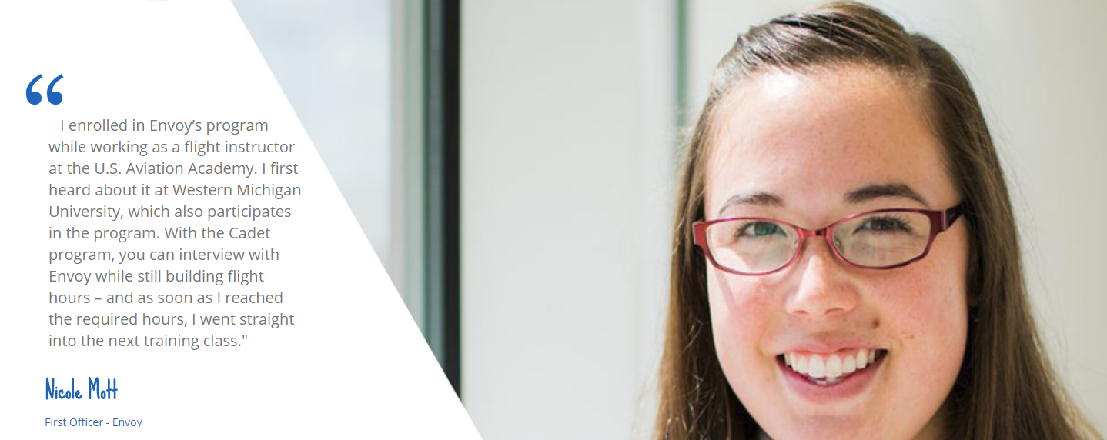
About US Aviation Academy
FAA Approved with Self-Examining
Airline Partnerships including Aviate, Envoy, and more
College Partnerships Across the Country
Safety Management System
Alumni Network to Build Your Career
A&P Training Program Available

Slide 4

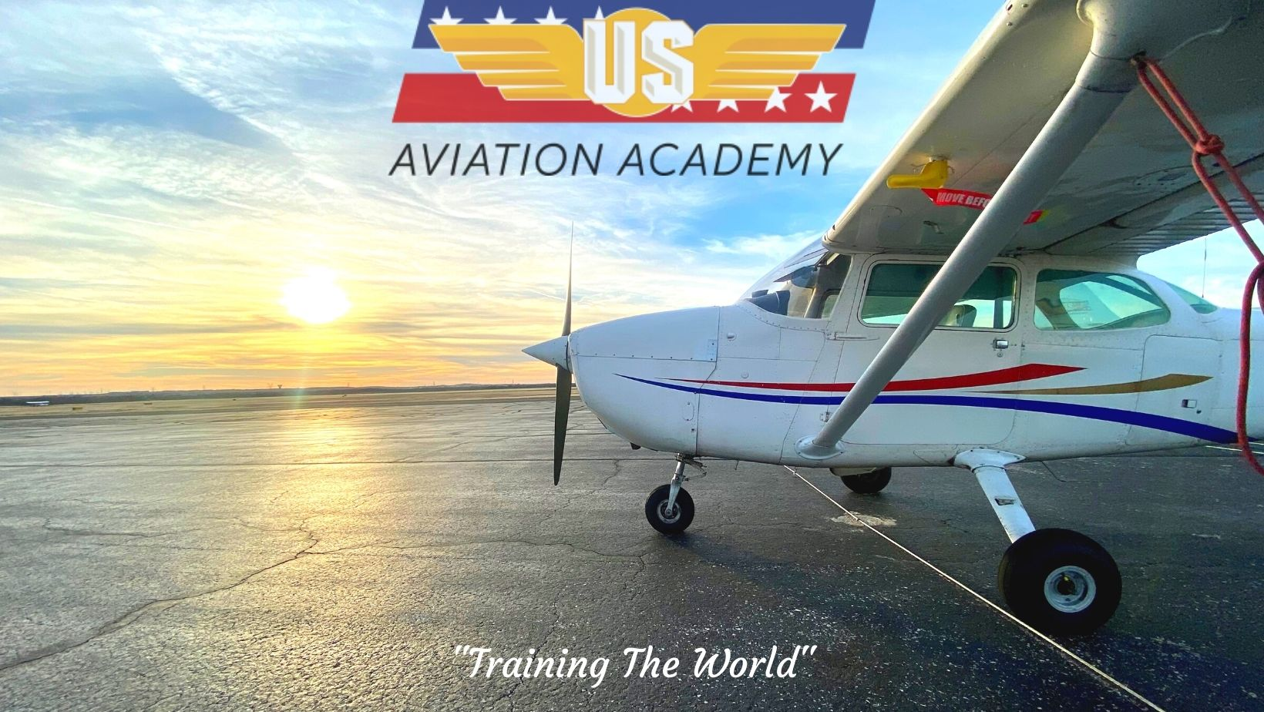
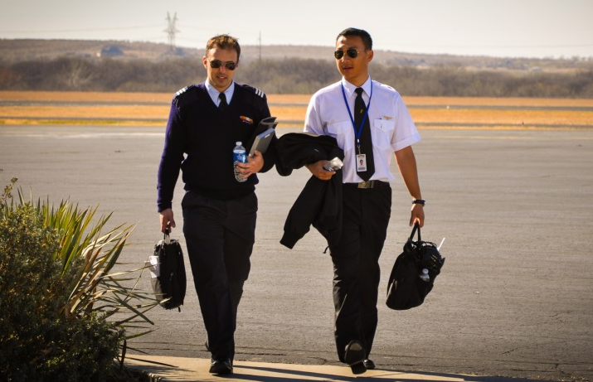
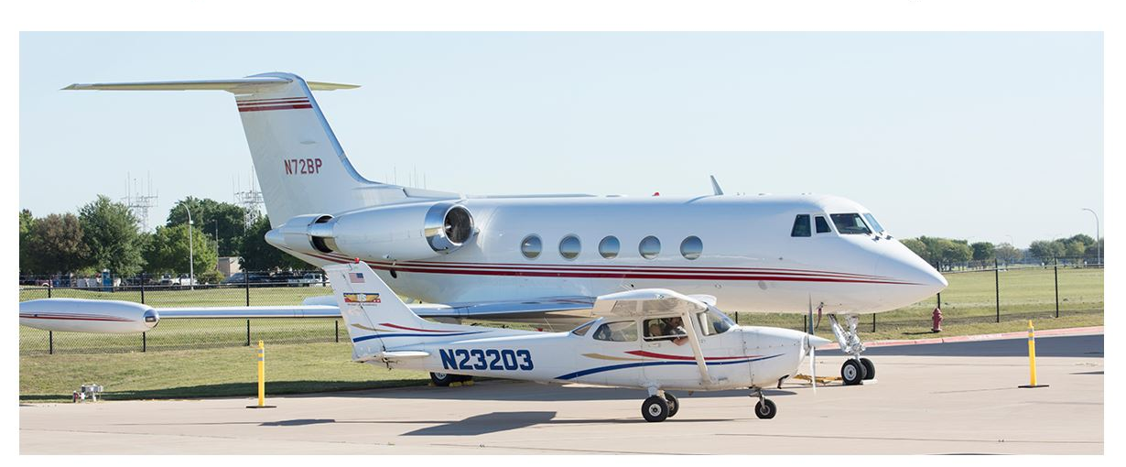
US Aviation
Professional Flight Training
FAA,CAAC, & EASA Part 141 Certified
FAA 141 Self-examining authority
Graduated thousands of pilots
40,000 Flight Hours in 2021

Slide 5
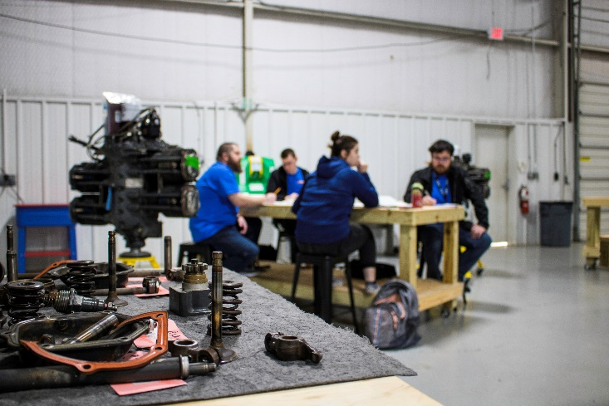
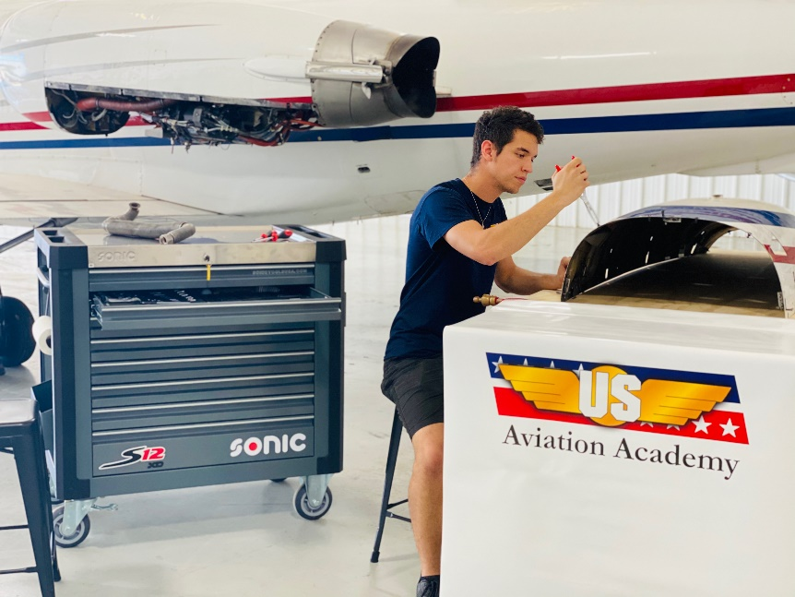
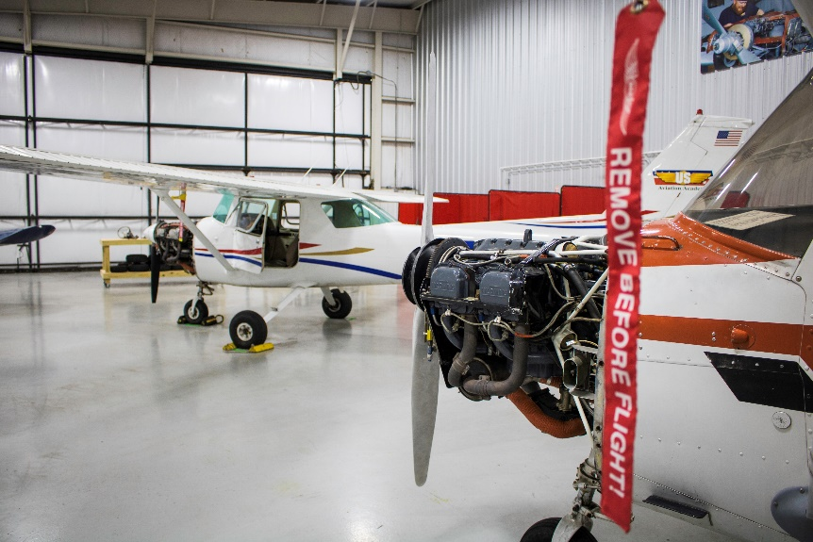
US Aviation
Aircraft Mechanic Training
FAA Part 147 Certified
On-Site written and practical testing
Learn at an airport, not a warehouse
Experience in a live maintenance shop

Slide 6
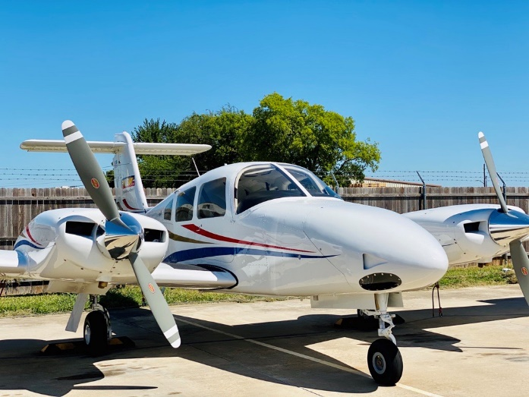
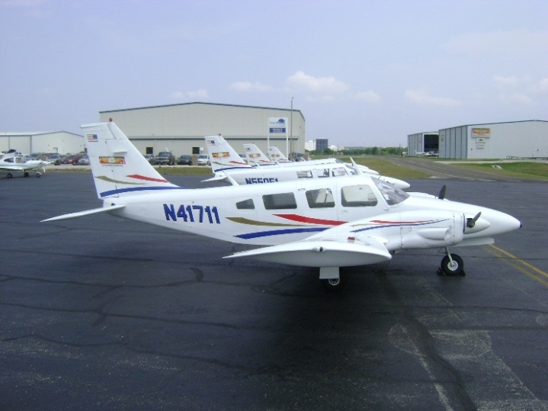
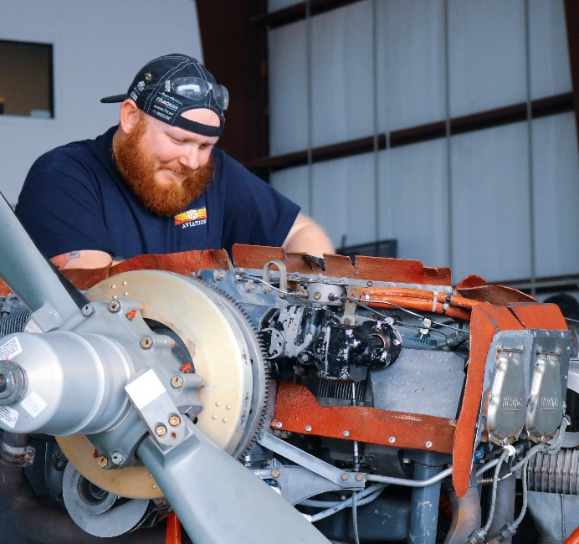
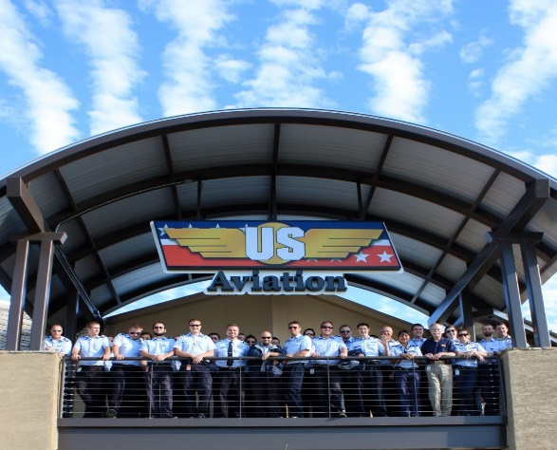
Aircraft and Instructors
~50 Instructors
48 Cessna 152
49 Cessna 172
19 Seneca I
3 Seminole G1000
1 KA C90 Level C

Slide 7
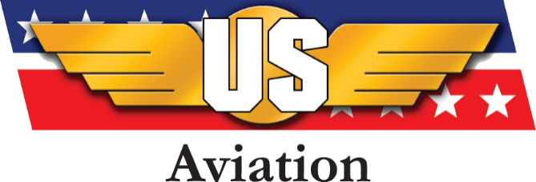
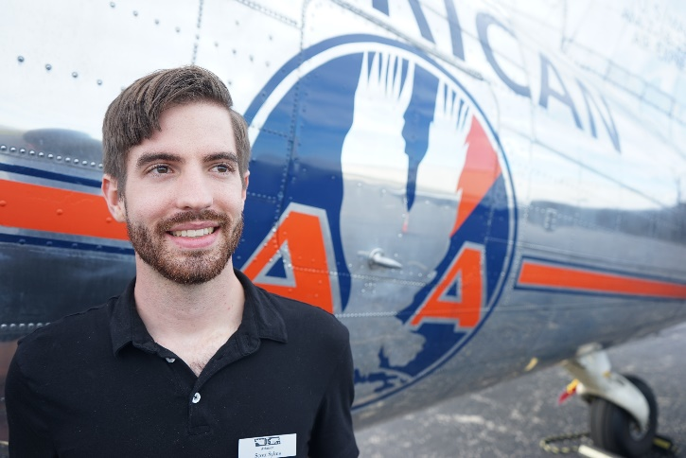
Key Management
Key Personnel
Scott Sykes – VP Business Development
  Bachelors of Finance and Economics from Baylor
  Masters of Economics from UNT
  Private Pilot

Slide 8
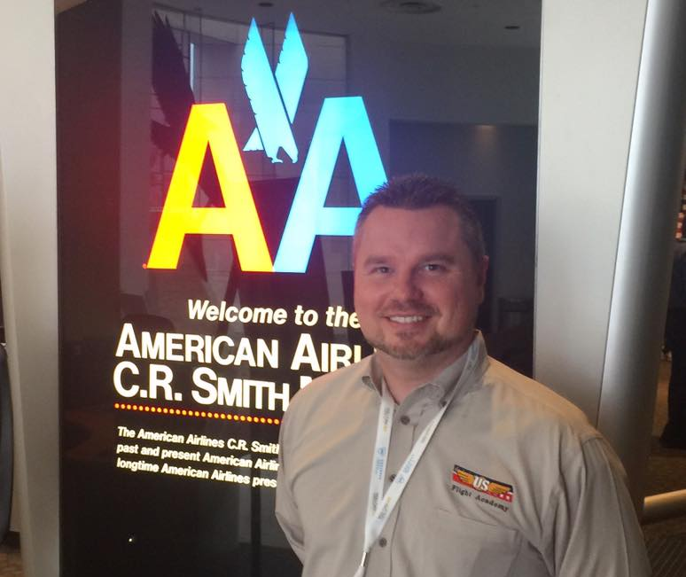
Key Personnel
Chris Ramey – Chief Instructor, VP Standards
  Graduate of Flight Safety International – Commercial Multi Engine Instrument
  Graduate of Southeast Oklahoma State – BS
  15 Years of Experience
    CFI, CFII, MEI, Check Pilot
  Grew within US Aviation
    Line Instructor
    Check Pilot
    Director of Admissions / SEVIS PDSO
    Director of Standards
    Director of Collegiate Programs
    VP of Standards, Chief Pilot
Key Management

Slide 9
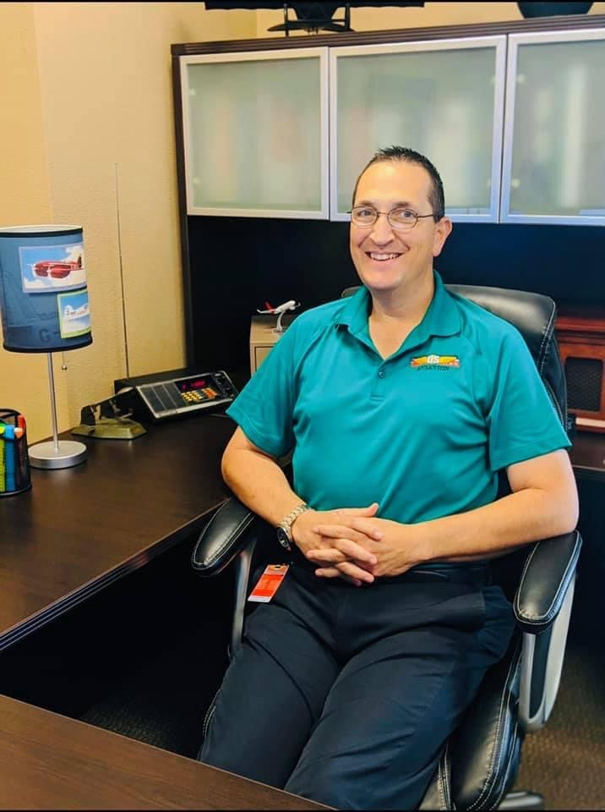
Ground school director & Safety officer
Rick Sanchez
  Rick’s commitment to safety is for all lessons taught and subject matter covered that safety is the main objective. From lesson one to the end, our goal is to train all pilots to be as safe, efficient, and as professional as possible. This is how our Safety Management System is structured.
  Sends out regular safety reminders to all staff and students to keep up the culture.
  Manages and responds to SMS tickets
Key Management

Slide 10
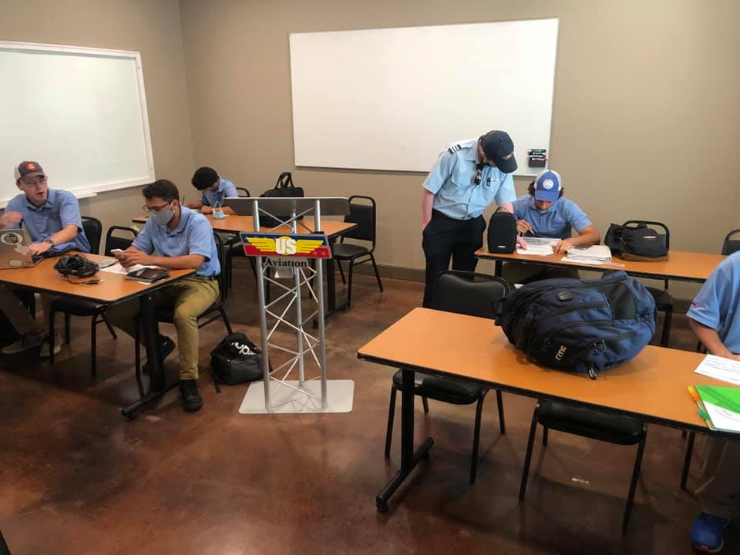
Lagrone Academy Ground School
Private Pilot
  Flight Physics
  Weather
  Aviation Regulations
  Aircraft Systems
  Flight Planning
This class is tough! Think of it like dual credit.
Notes:
Page 21

Slide 11
Grading and Attendance
DISD grade and attendance will be done as normal, but US Aviation Academy will separately keep FAA Part 141 records.
The FAA has strict grading/attendance policies!
  Missed time must be made up
  Class must be passed with an 80% or greater
  FAA Written Private test can be taken once passed

Slide 12
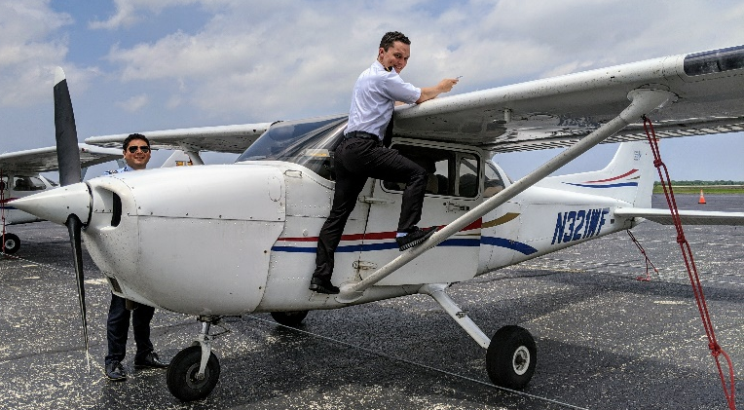
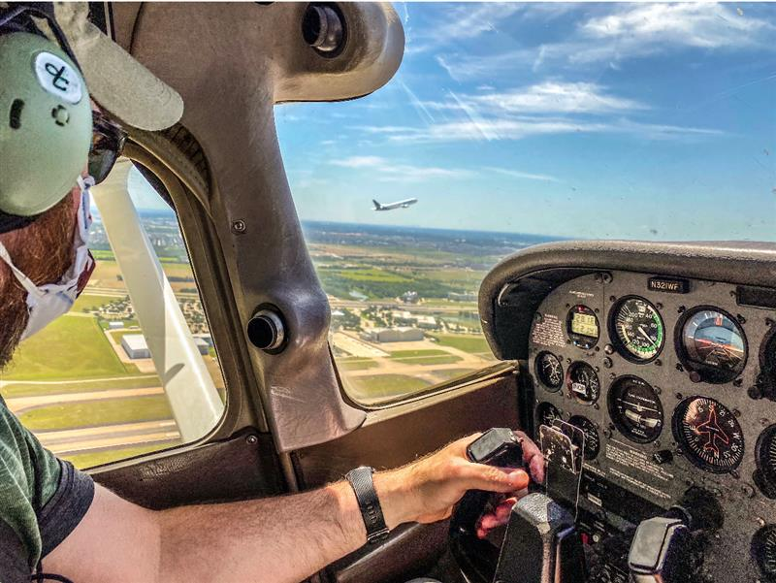
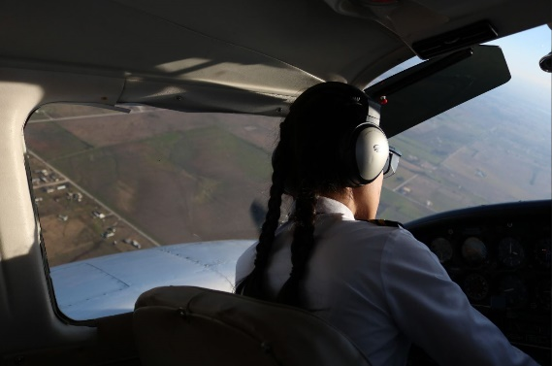
Curriculum
Private
  Min. 35 Hours, Average 50-60 Hours
Instrument
  Min. 35 Hours Instrument, Average 30 Flight, 10 Sim
Commercial – Single or Multi Initial
Flight Instructor
  CFI: 25 Hours (average and minimum)
  CFII: 15 Hours (average and minimum)

Slide 13
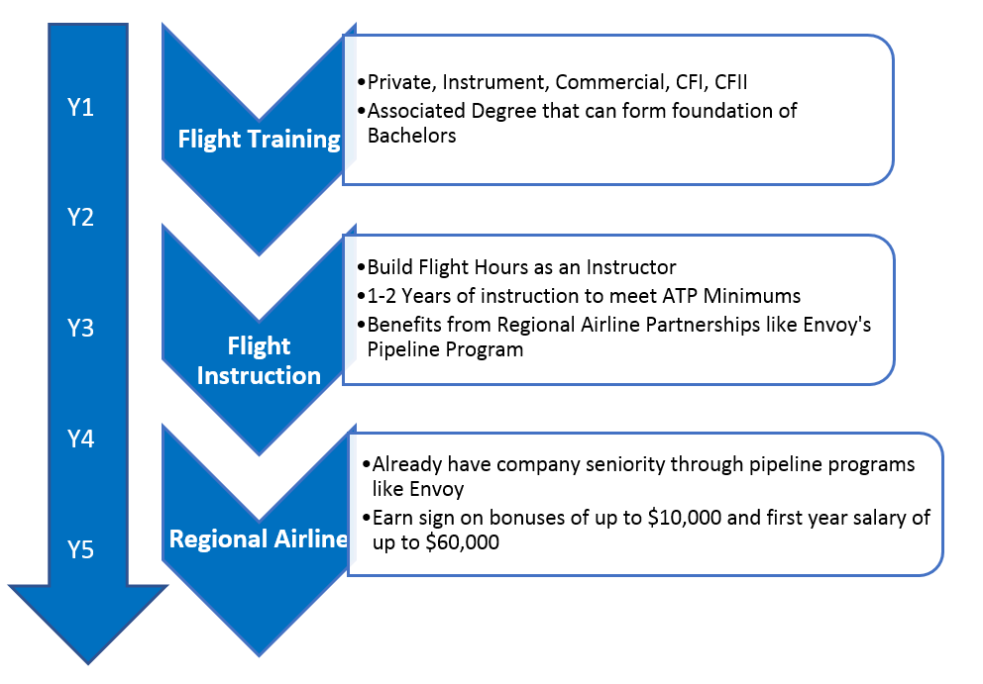
Typical Career Path

Slide 14
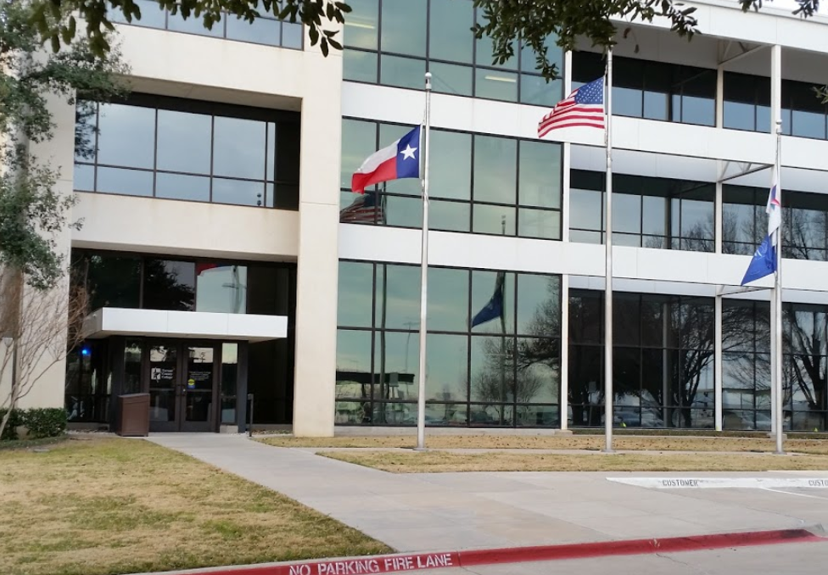
TCC DEGREE PROGRAM
Semester 1 – Private Pilot
Semester 2 – Instrument Rating
Semester 3 – Commercial 1
Semester 4 – Commercial 2
Semester 5 – Multi Engine
Semester 6 – Certified Flight Instructor
AAS Degree Plan = 2 Years

Slide 15



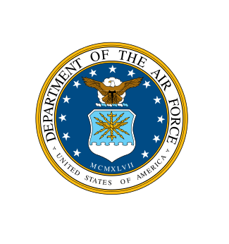
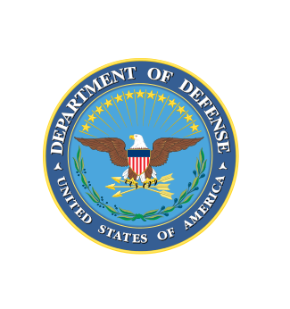

Partner Colleges
Tarrant County College
  AAS in Professional Piloting
  Expected Enrollment of 125+ Students 2020
Lone Star College
  Started January 2020
  Grew to 60 students in 3 semesters
Southeast Missouri State University
  New 4-year bachelor’s aviation program
  Starting August 2021
Dutchess County College
  Selected as provider starting January 2021
Pilot Flight Academy
  Partnered with one of Europe’s largest and most modern flight academies (Norway)

Slide 16
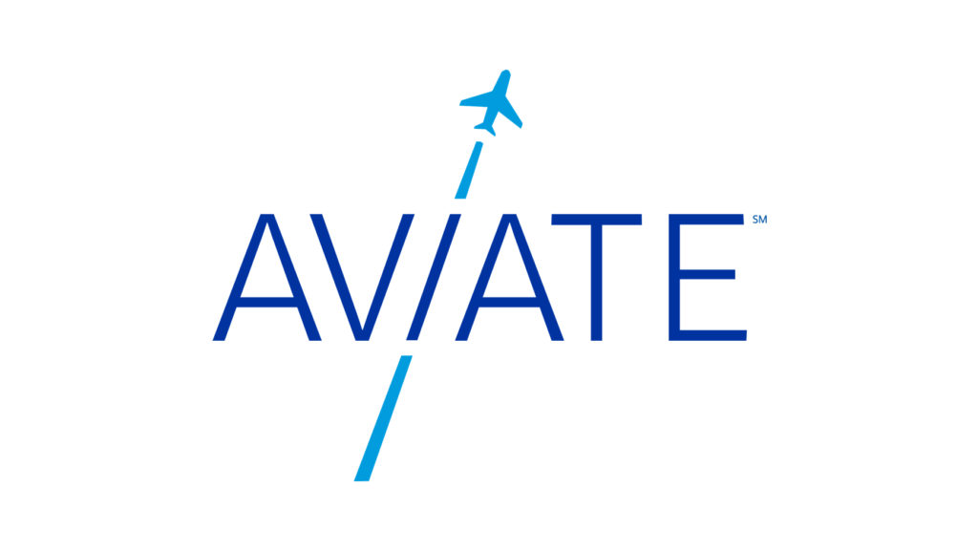
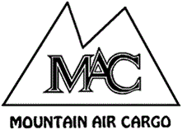




Other PIPELINE programs / Airline Affiliates
Pipeline Programs
Envoy
United Airlines - Aviate
Southwest Airlines - Destination 225
Airline Affiliates
Mountain Air Cargo
Republic Airways
Piedmont
SkyWest Airlines

Slide 17

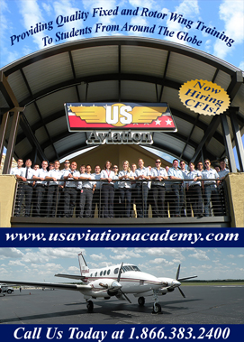
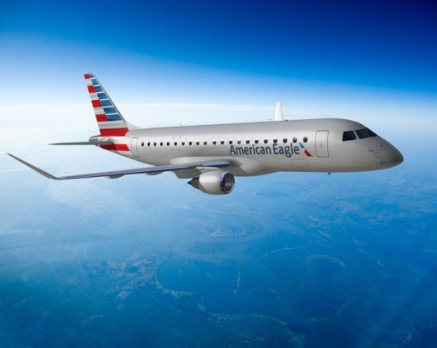
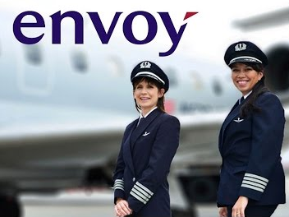
Envoy Pipeline Program
Envoy “American Eagle”
First Pipeline program partner
Strategic recruitment initiative
Fast-track to Airline career
US Aviation - 5 locations
Boeing study predicts over
600,000 pilots needed over
next 20 years worldwide

Slide 18
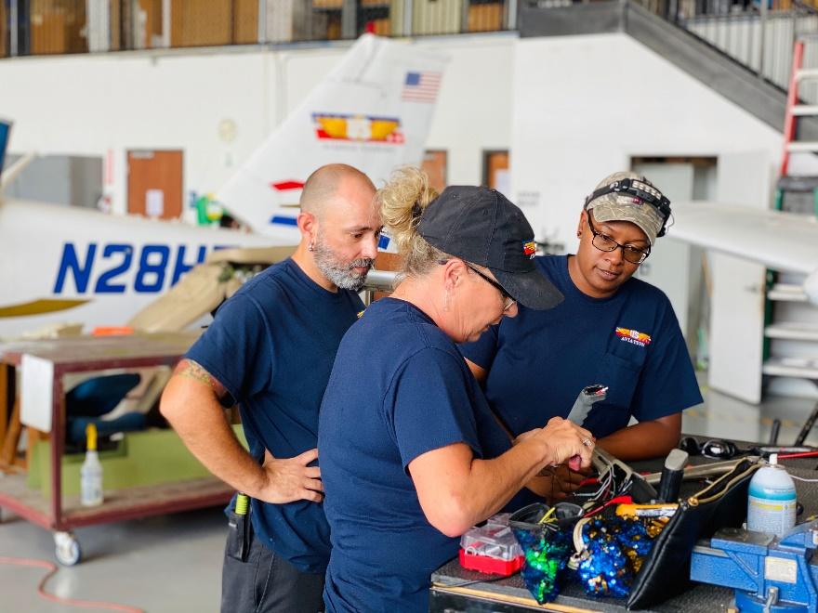
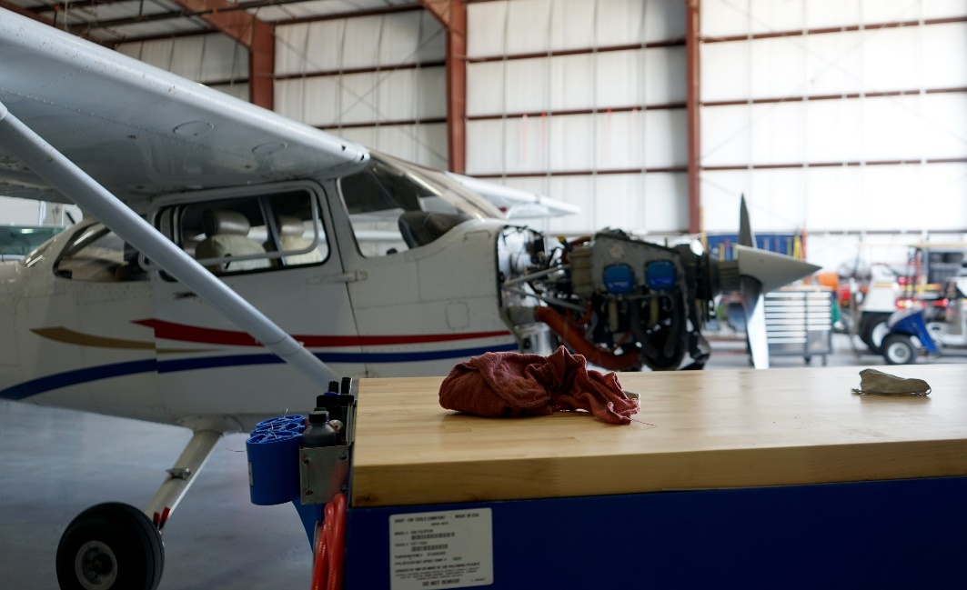
A&P Program Overview
12 Months from HS graduate to FAA A&P
Starting A&P wages $20-$25/hour
Experienced A&Ps make $30-$45/hour

